Slide 1
Medicinal Plants Cultivation under NAM
SMPB HIMACHAL PRADESH
FINANCIAL YEAR 2019-20

Slide 2
PROGRESS REPORT CONCERNING ACTIVITIES
W.E.F. – 30/04/2019 ONWARDS
WORKING SPHERE
SURROUNDING AREA OF AHC DALOH SUBDIVISION DEHRA TEHSIL KHUNDIAN DISTT. KANGRA H.P

Slide 3
August 2019
1) Total 19 farmers
2) Five clusters
3) Seven villages.
Financial aid from the Ayush department through SMPB.
Cultivation of
  2C Tulsi,
1C Ashwagandha
2C Sarpagadha

Slide 4
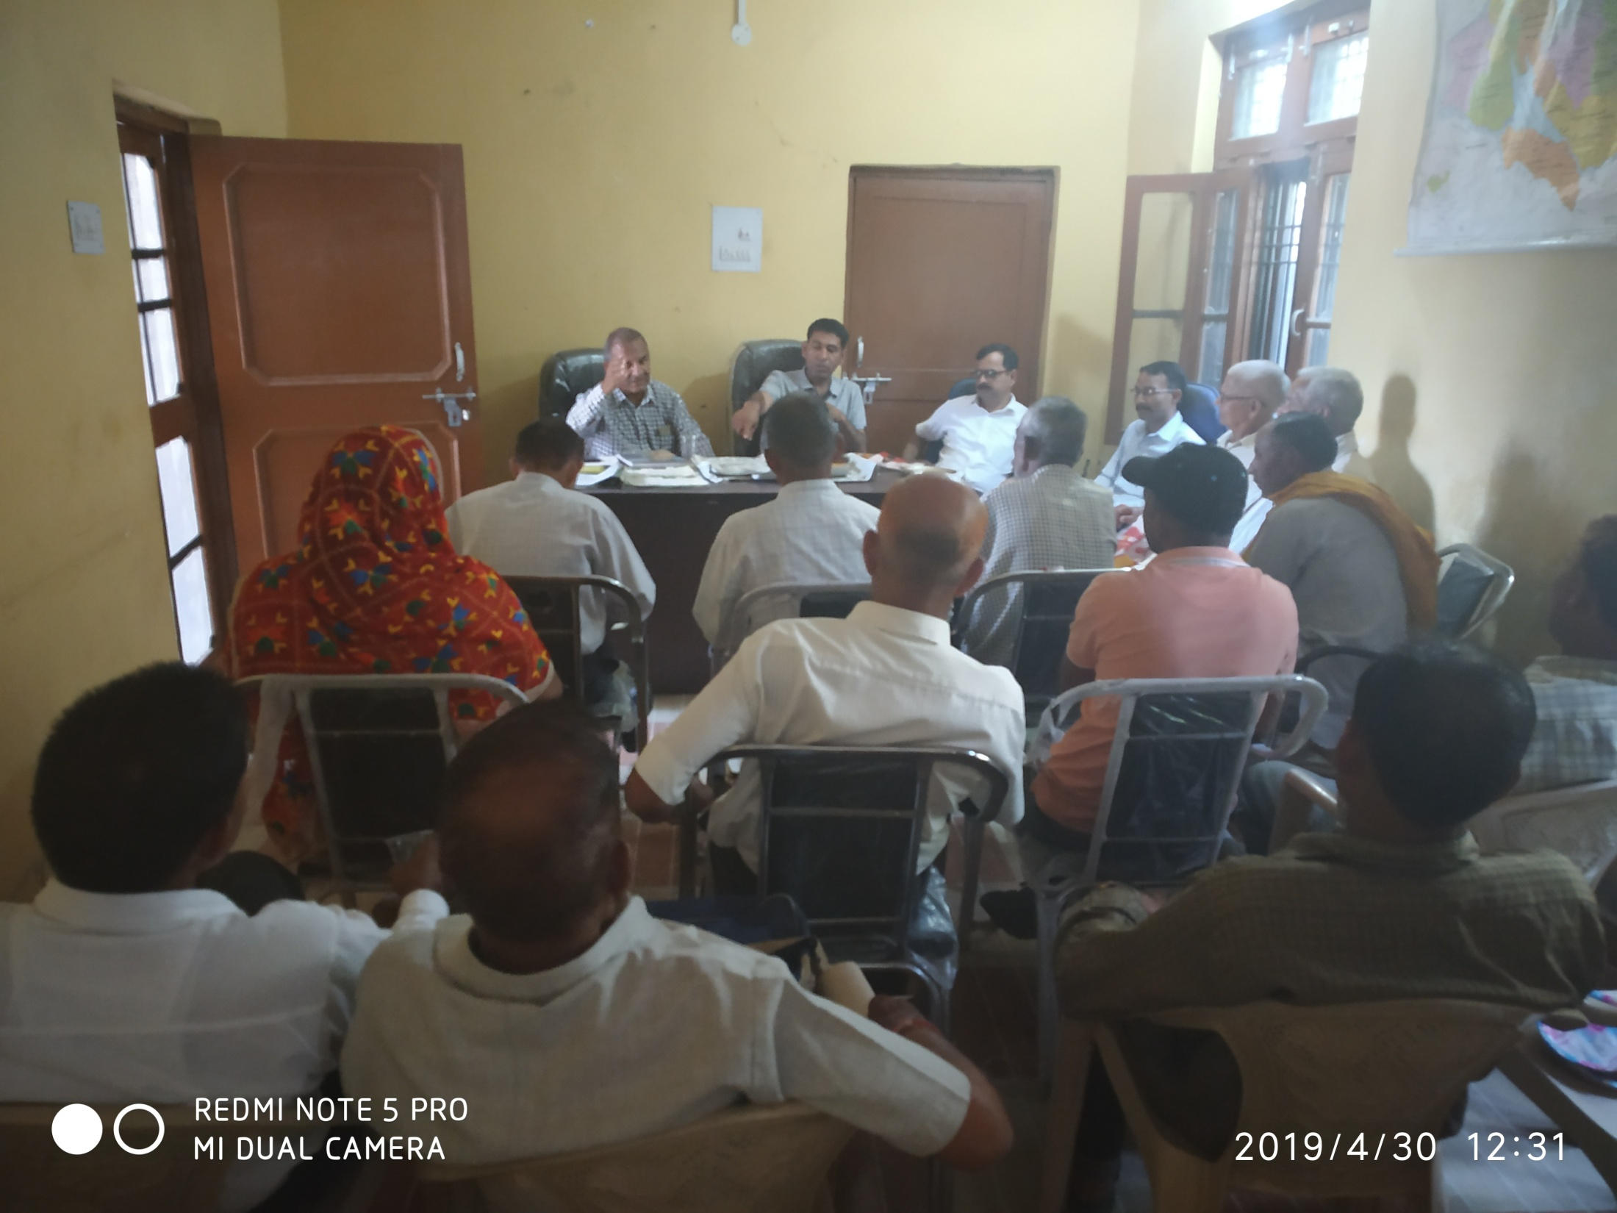

Slide 5
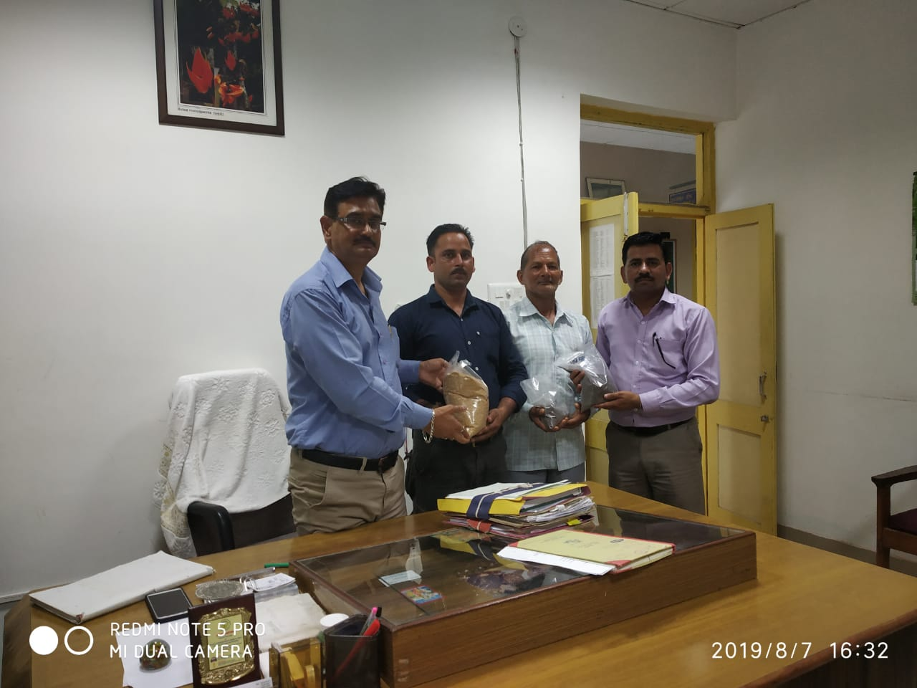

Slide 6
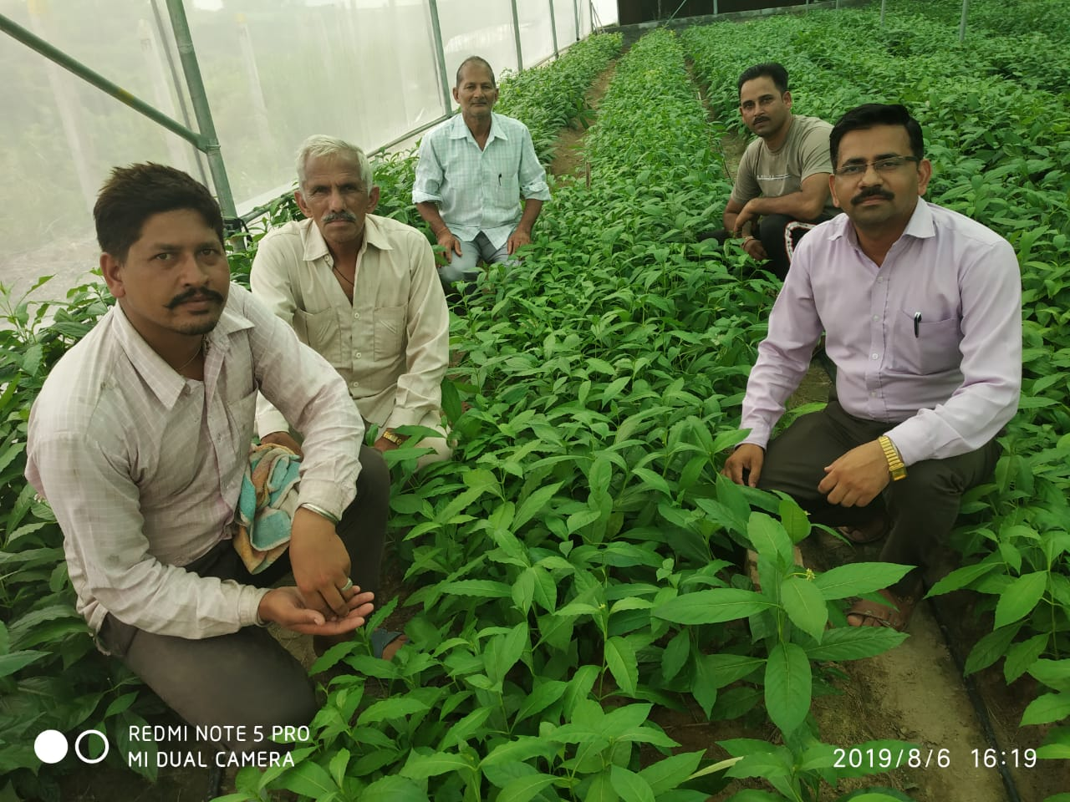

Slide 7
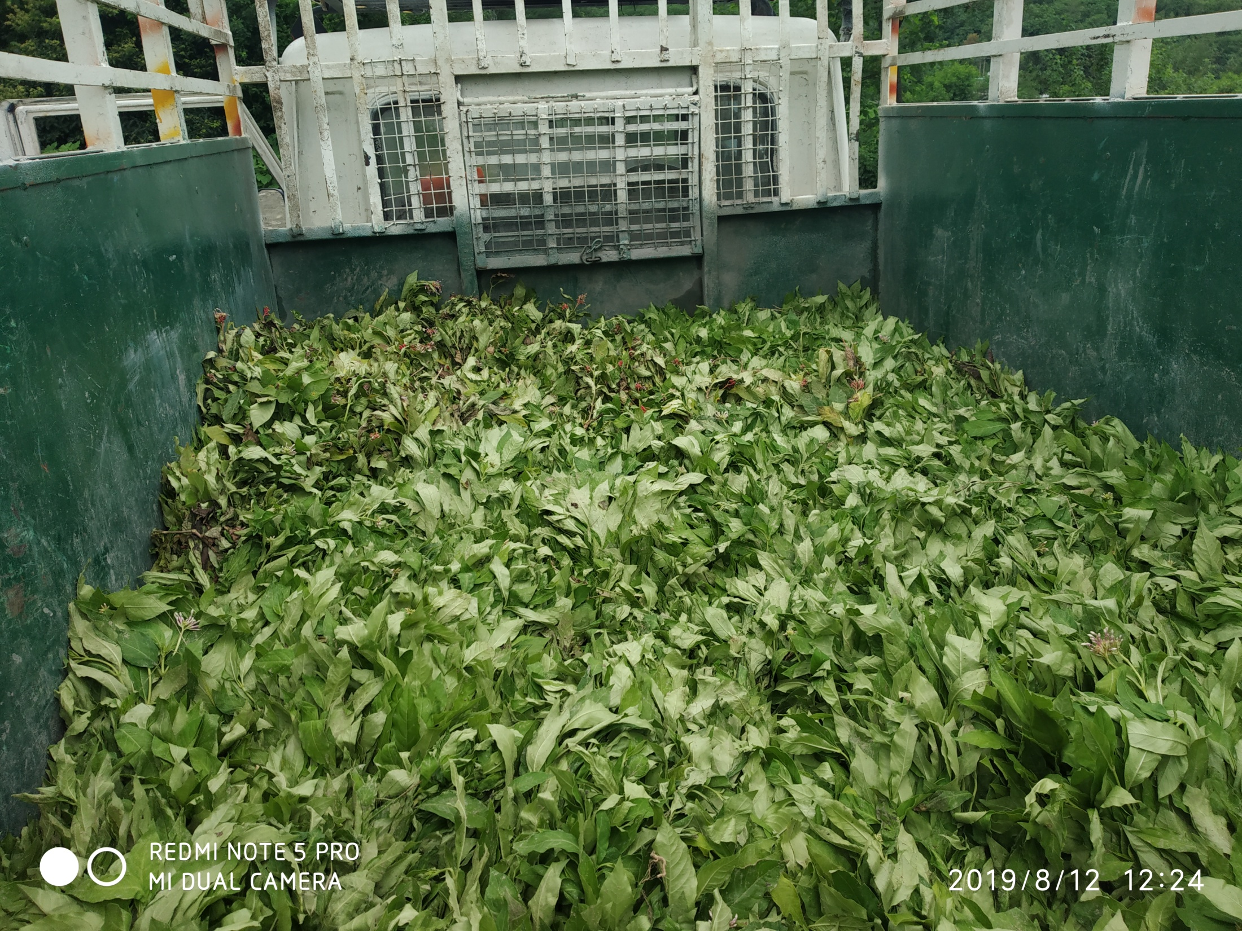

Slide 8
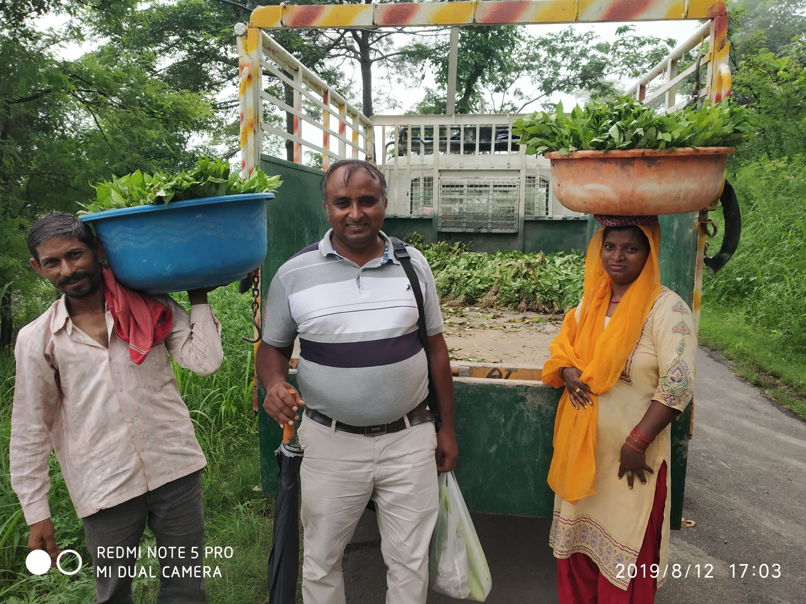

Slide 9
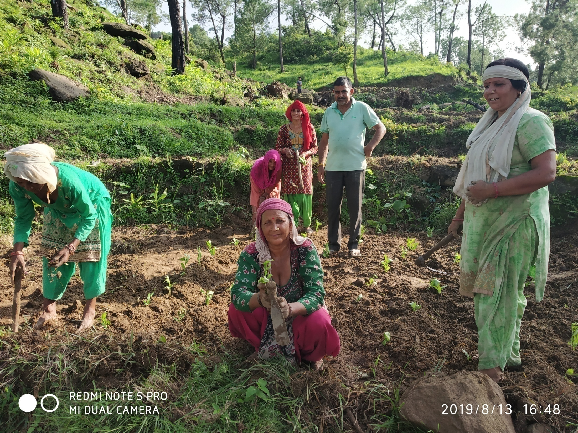

Slide 10
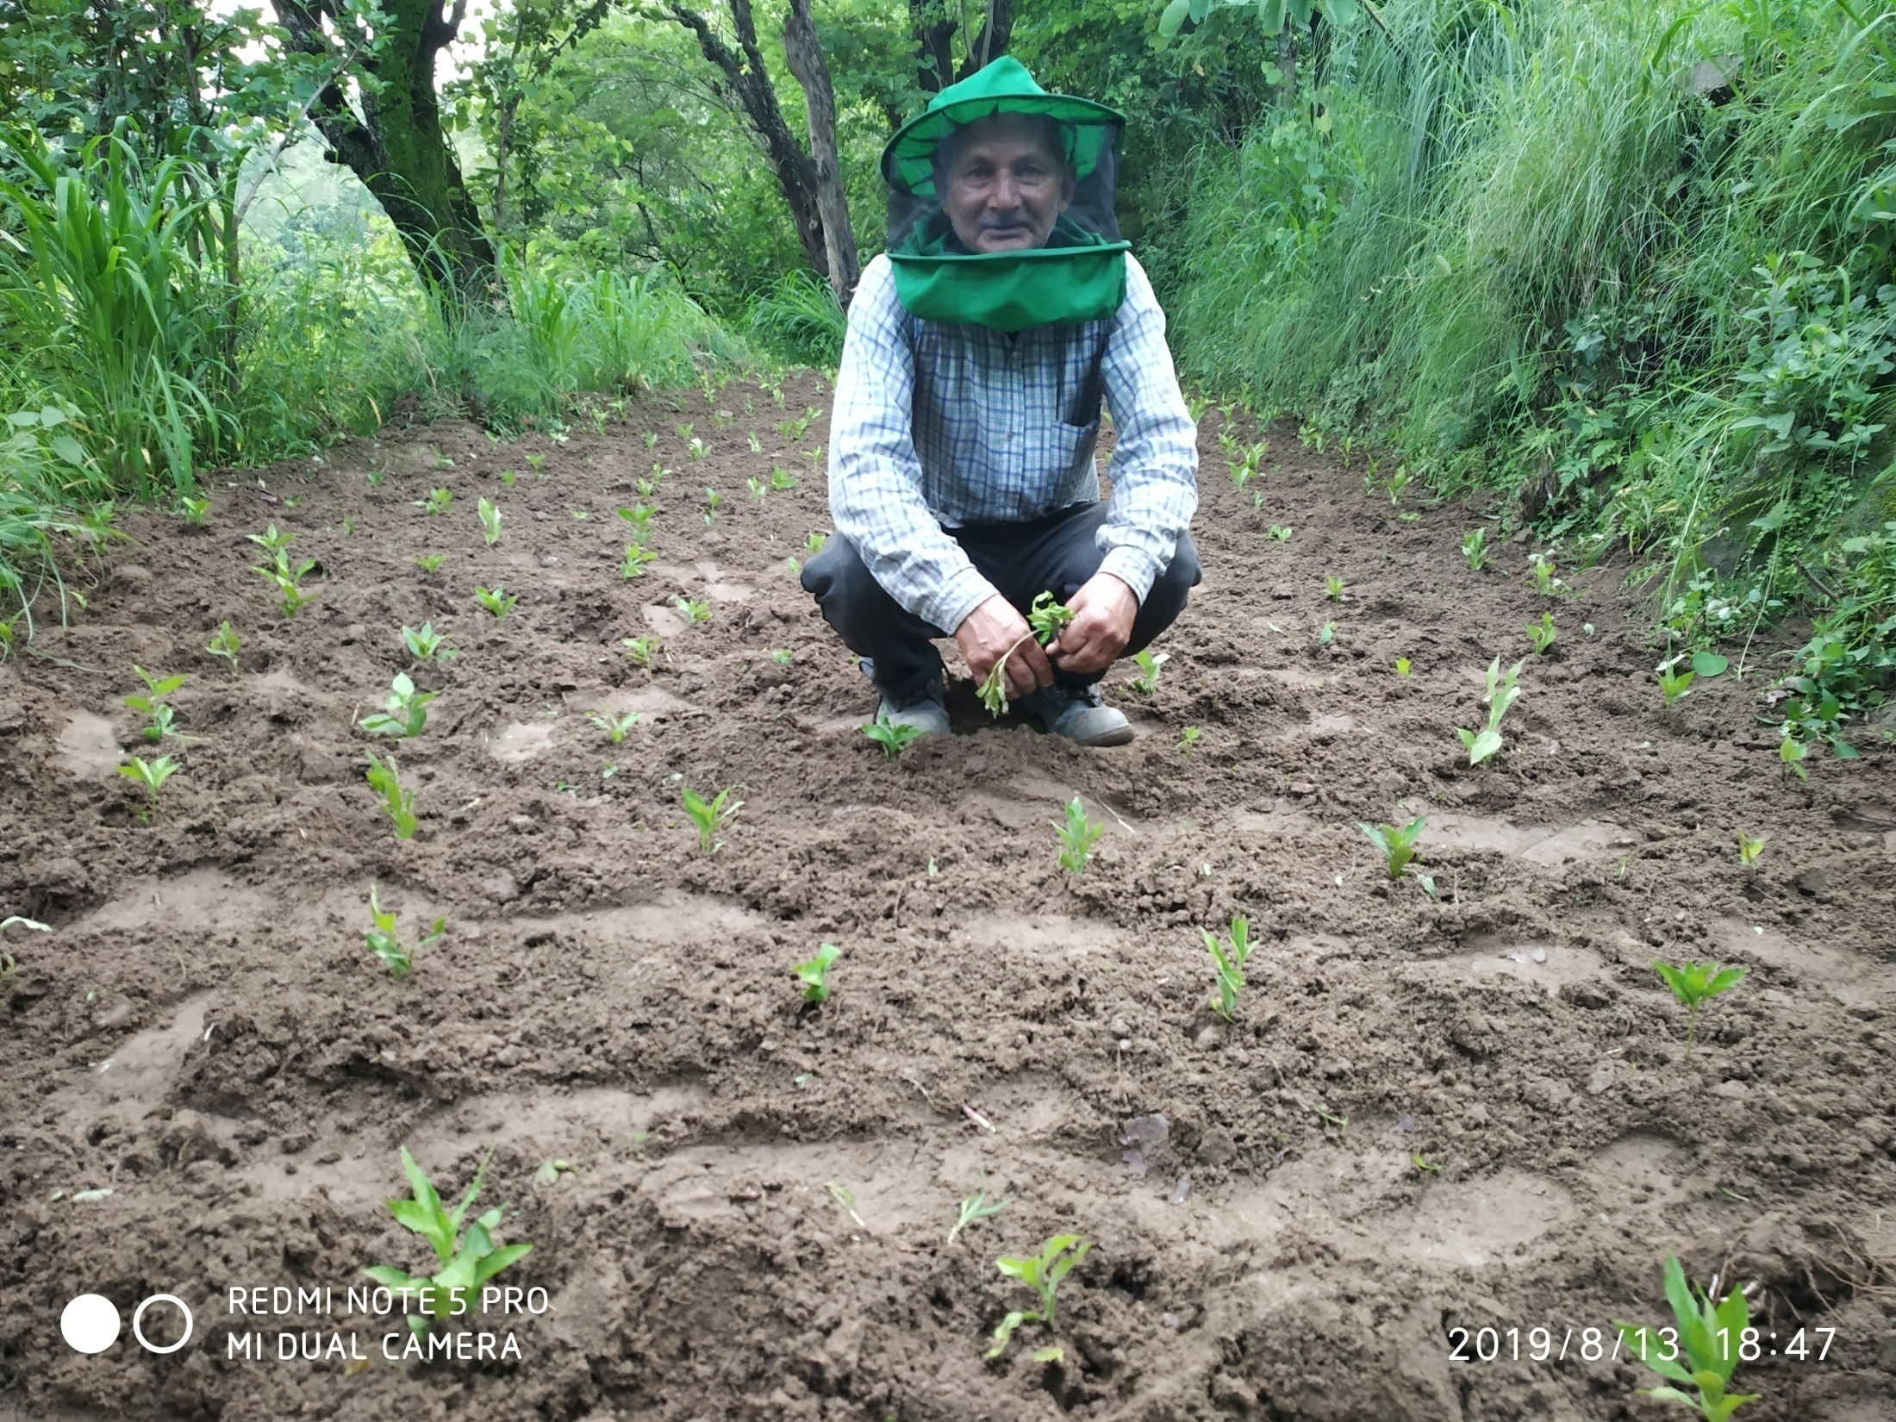

Slide 11
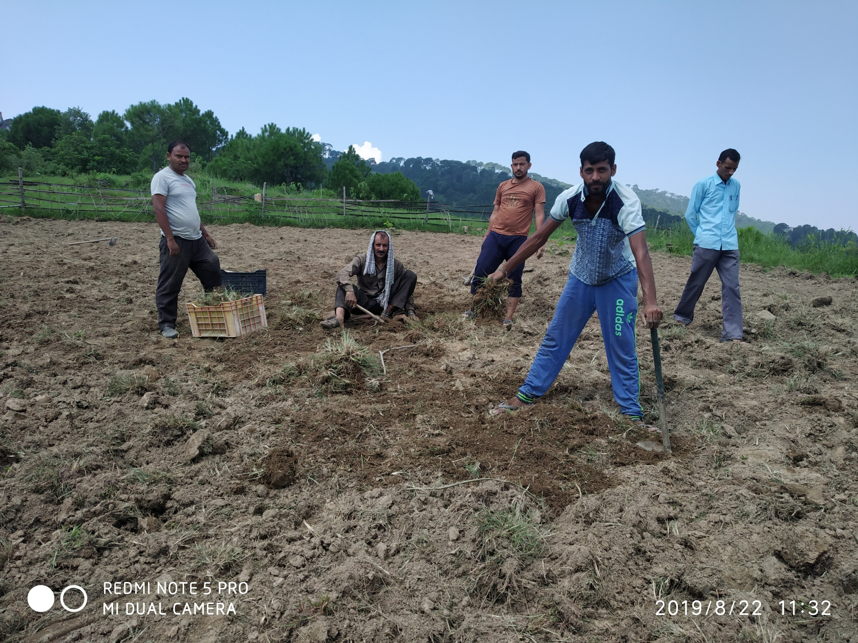

Slide 12
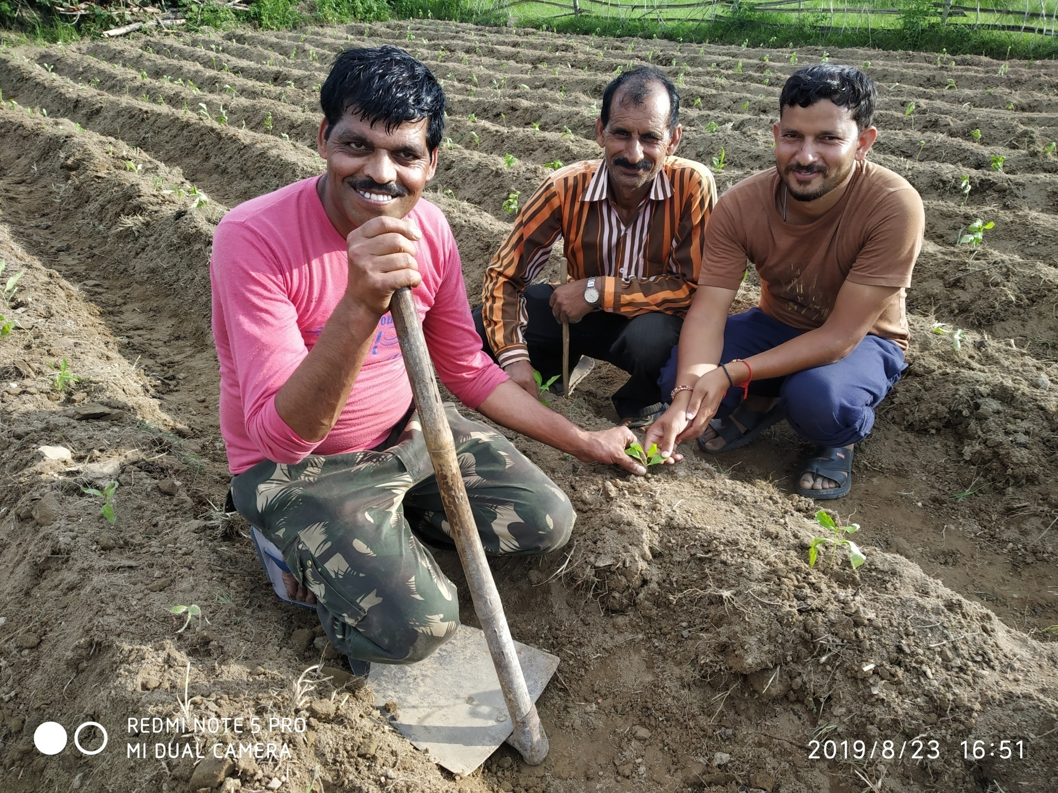

Slide 13
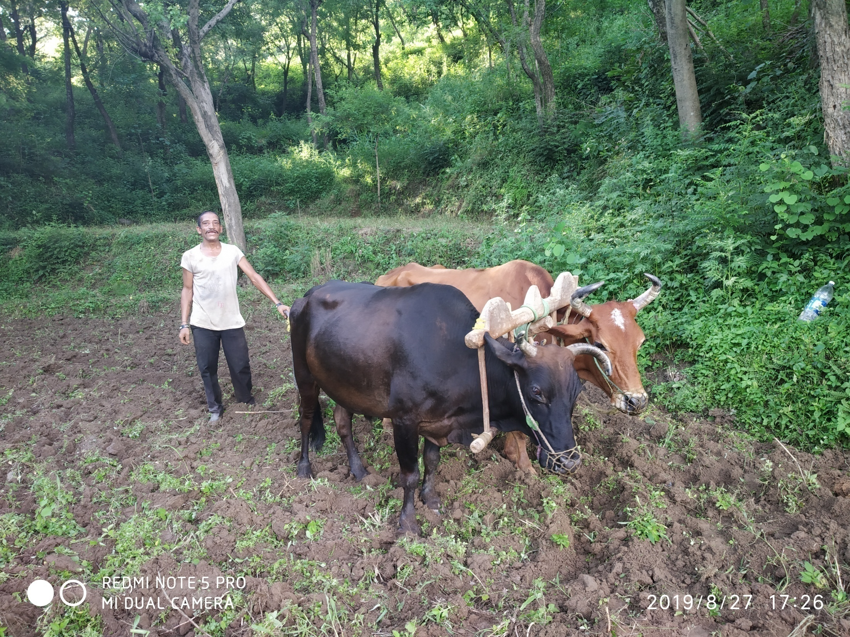

Slide 14
FORMATION DATE – 22/10/19
MPC - SHG

Slide 15
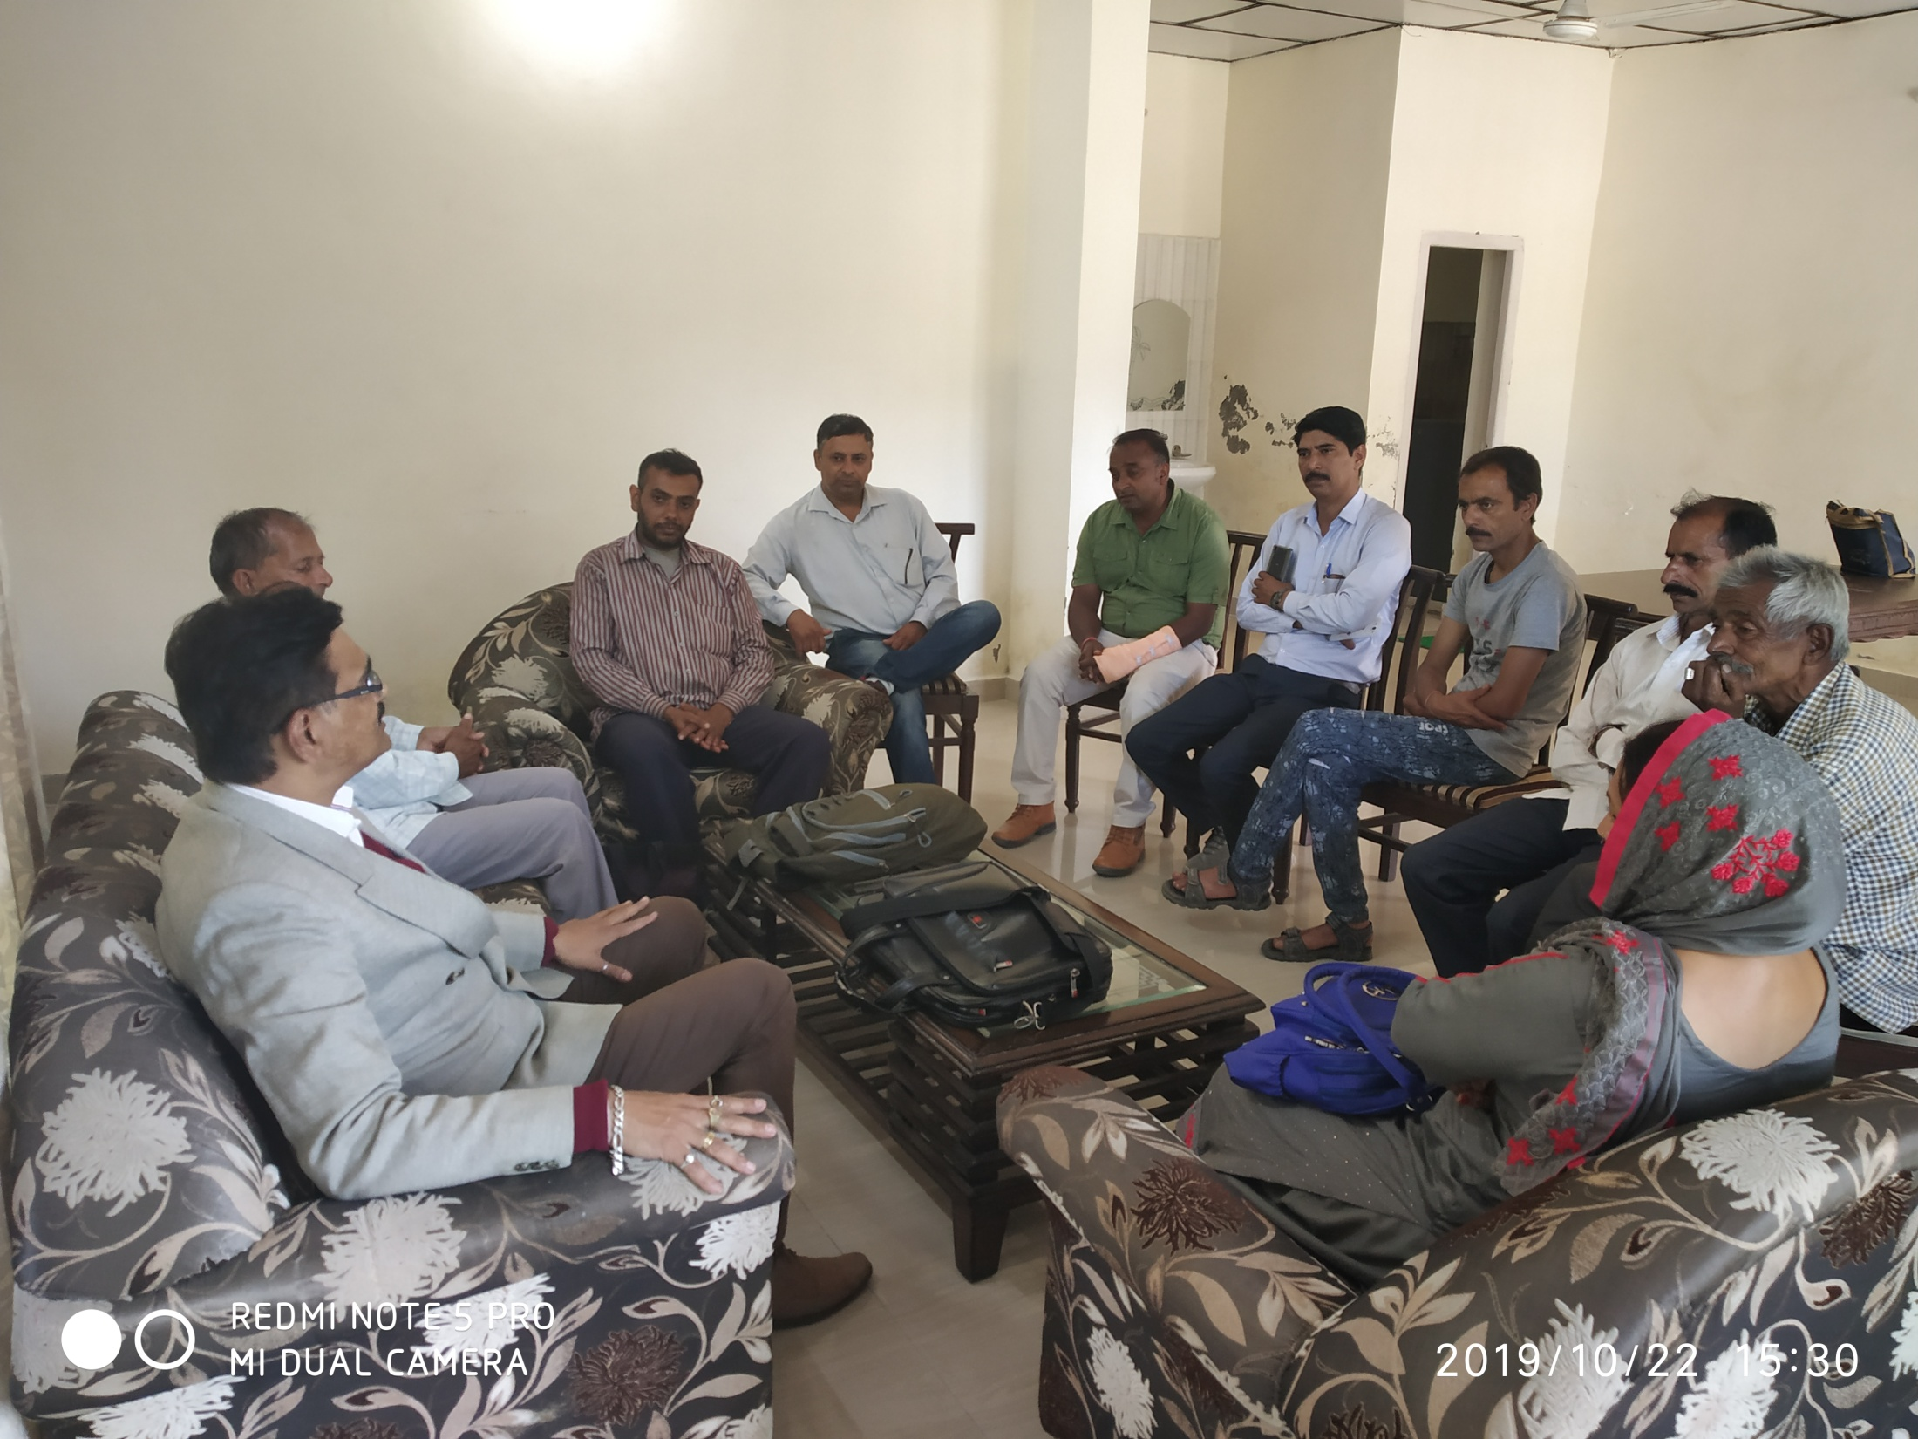

Slide 16
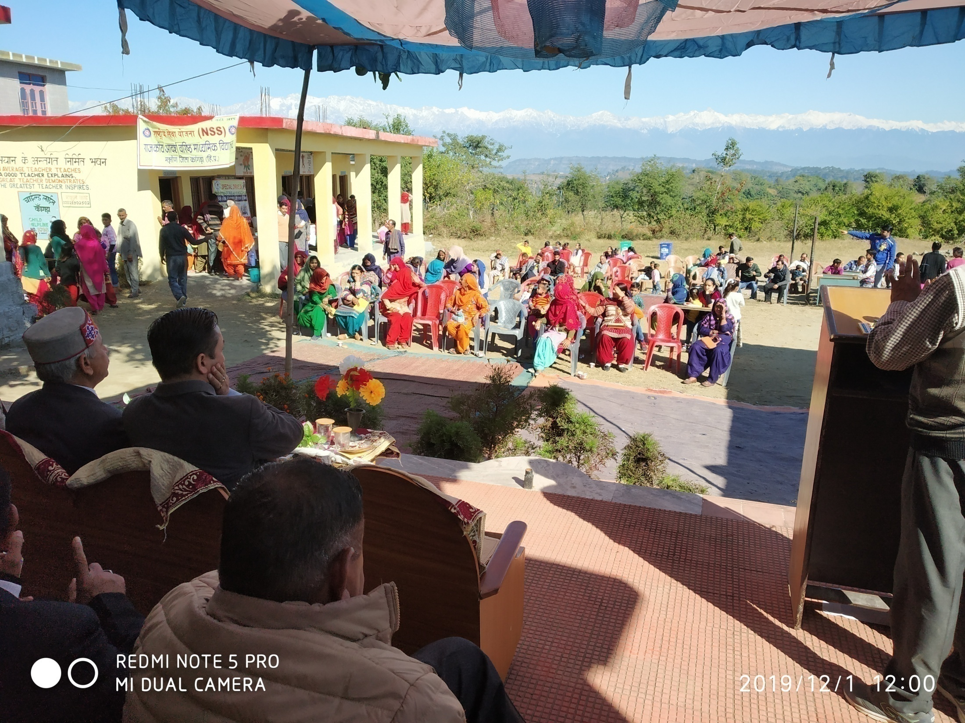

Slide 17
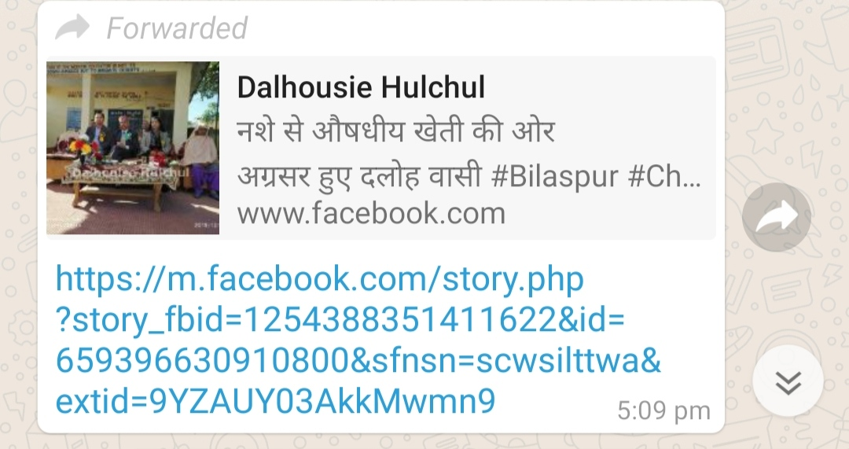

Slide 18
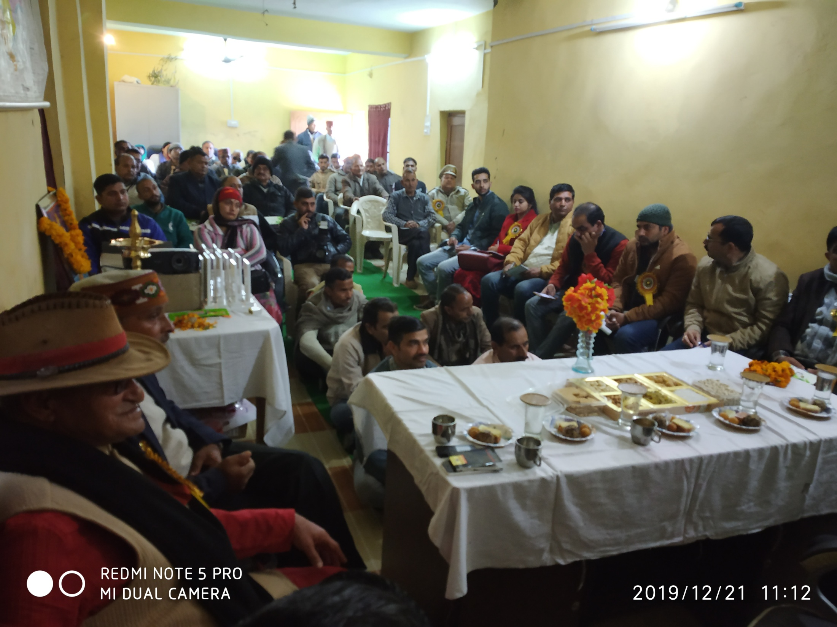

Slide 19
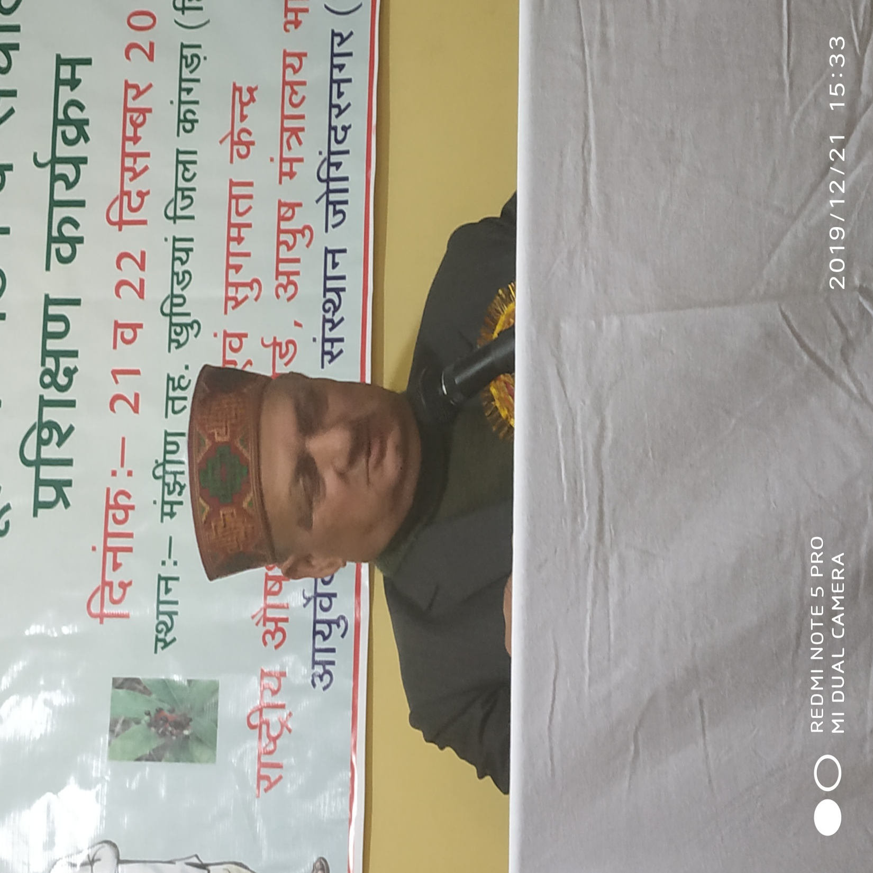

Slide 20
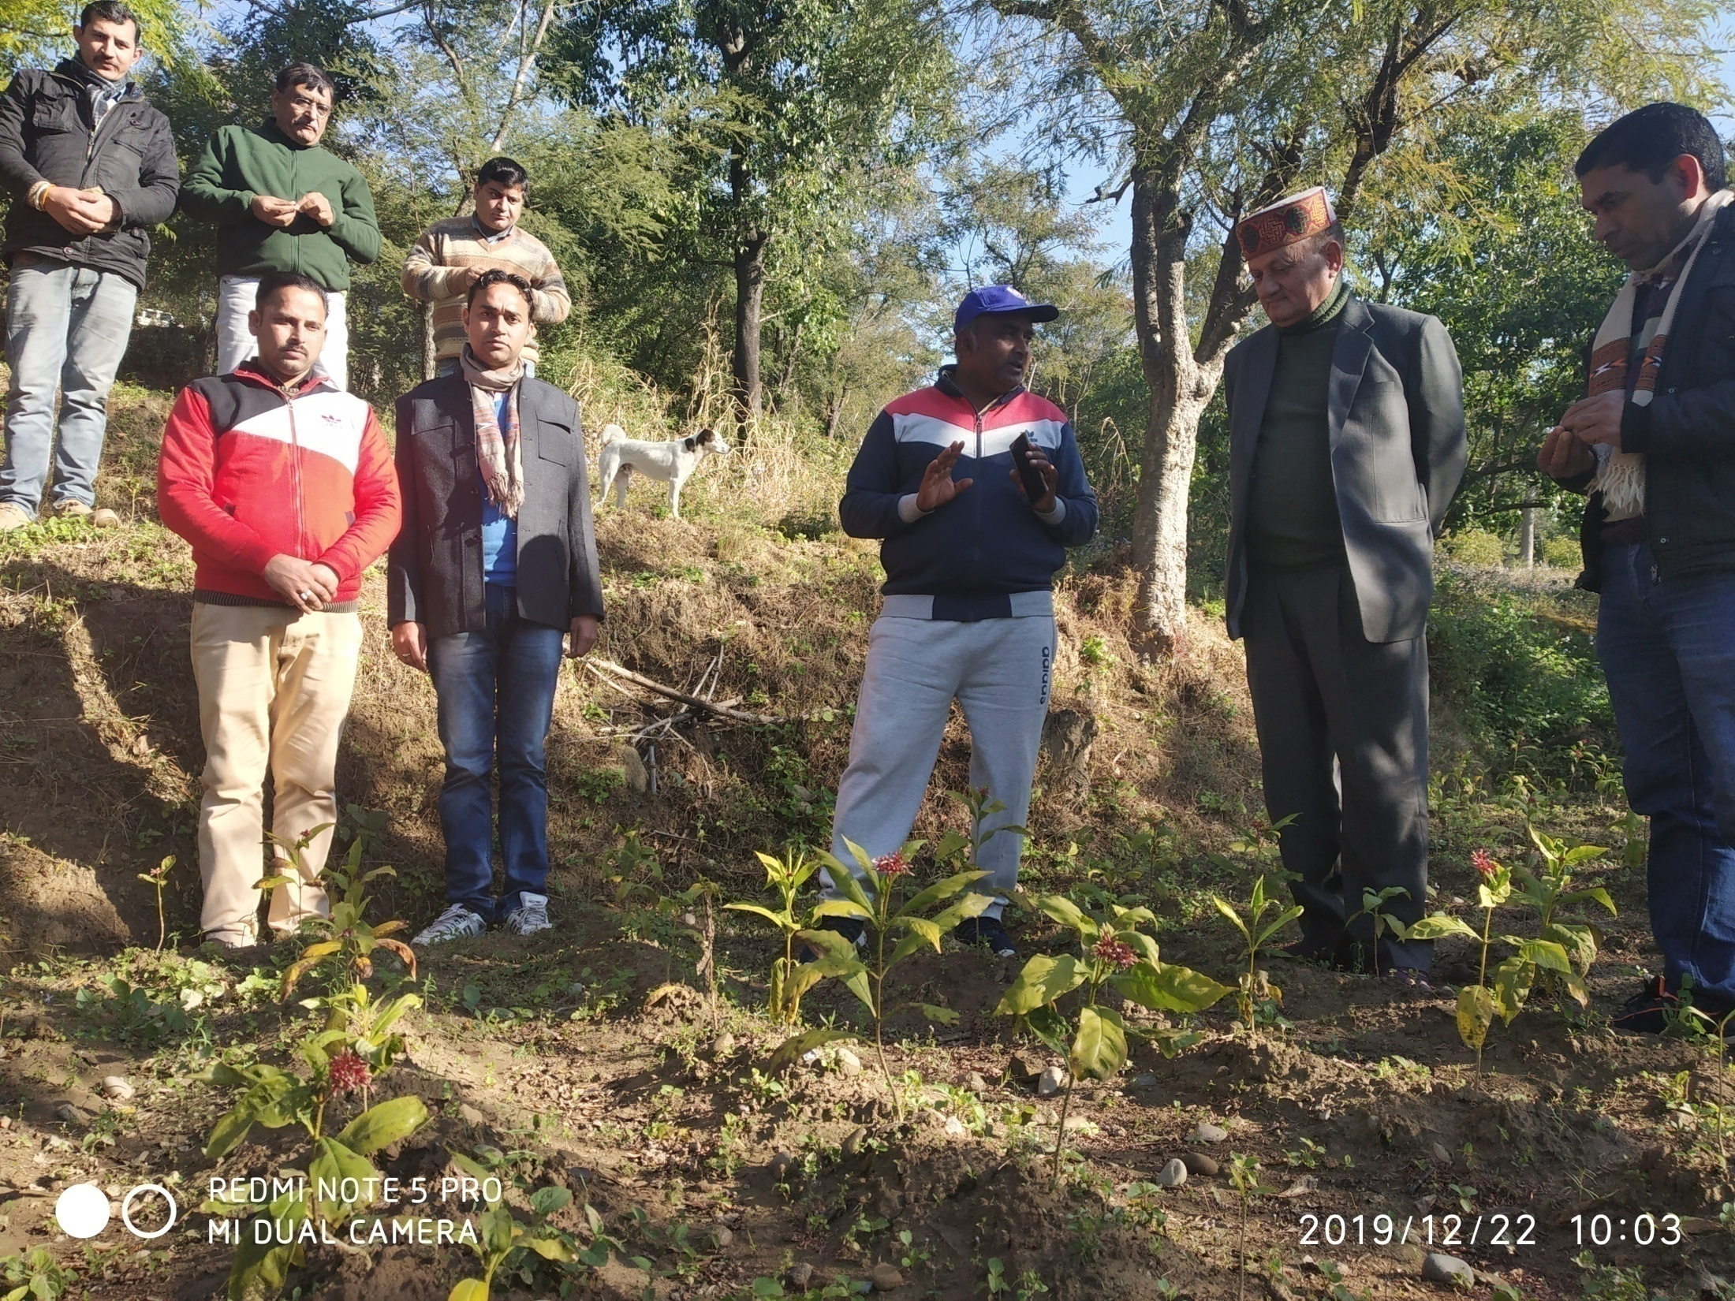

Slide 21
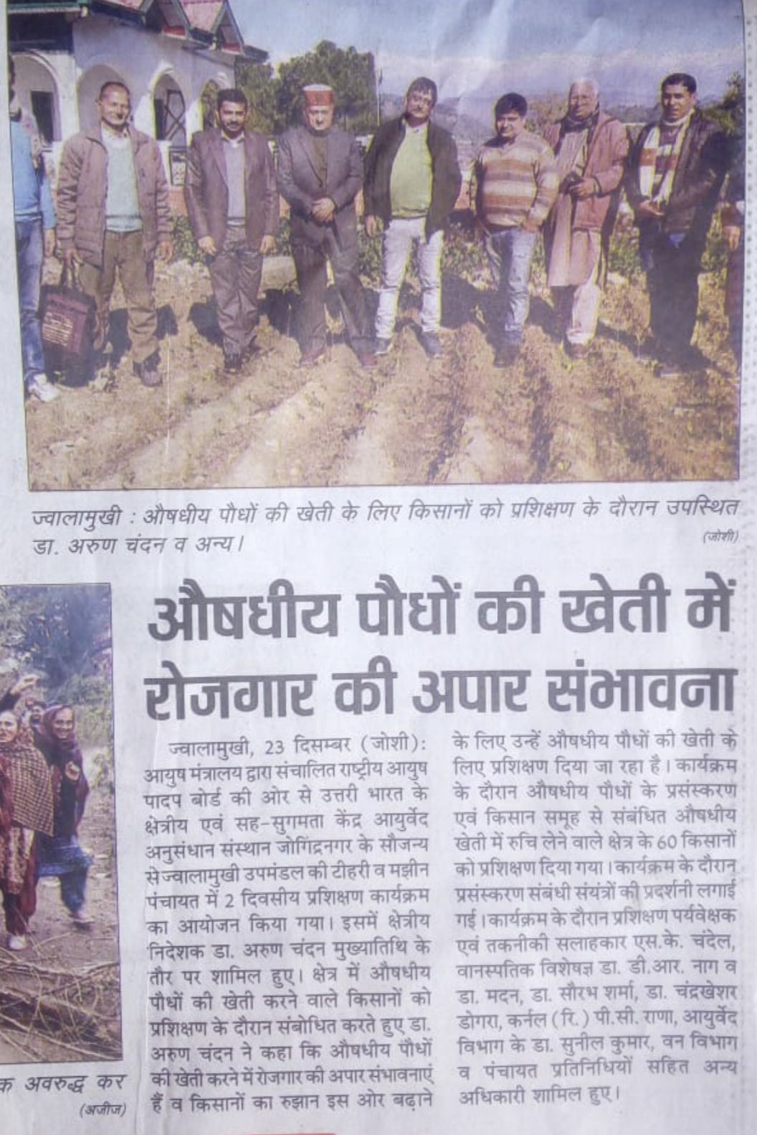

Slide 22
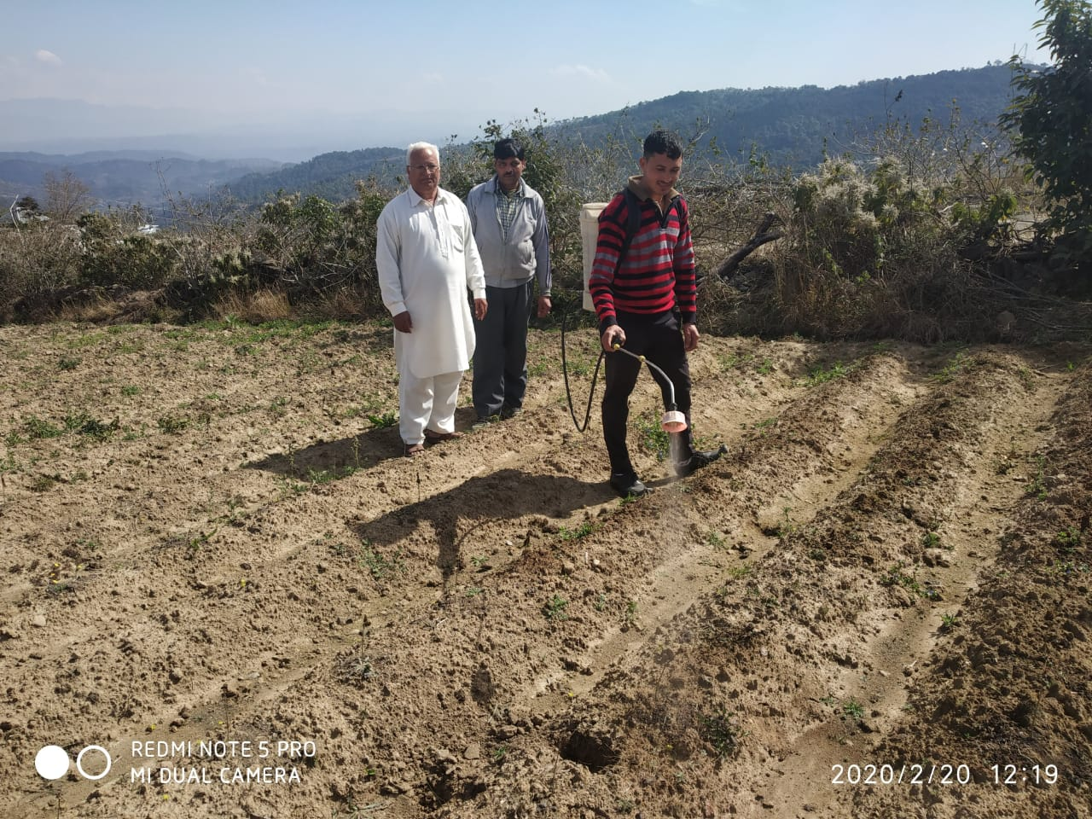

Slide 23
CHALLENGES ENCOUNTRED
Crop not thrived well- P.Reasons
Damage during transportations
Delay in transplantation
Dearth of care
Adaptability issues
Lack of knowledge / awareness
Lack of Training for medicinal farming
Uncertain forward and backward linkages
Lack of medicinal plants nursery nearby

Slide 24


